Slide 1

DATA 605- Ethical Issues in Data Science
ETHICS QUEST
Platform For Data Ethics Education Through Play
Sruthi Kapudasi
Harshitha Josyula
Mera Mathew
Nirvika Rajendra

Slide 2

INTRODUCTION
Why Ethics Quest?
Traditional training methods often fail to engage
Complex scenarios are difficult to grasp
Real-world implications are hard to visualize
Limited practical application opportunities
Our Solution: Gamified Learning Through Interactive Scenarios

Slide 3


GAME COMPONENTS
Core Elements:
1. Game Board
45 challenge spaces
Color-coded categories
Progressive difficulty levels
2. Challenge Cards
Privacy Scenarios
Security Challenges
Ethical Dilemmas
Compliance Questions
Innovation Challenges

Slide 4



GAME COMPONENTS
4. Game Markers
Player tokens
Score trackers
5. Additional Components
Quick reference guides
Scenario handbook
Solution manual
Team collaboration sheets
Decision tracking cards
3. Player Roles & Resources
6 Unique professional
roles
Role-specific abilities

Slide 5
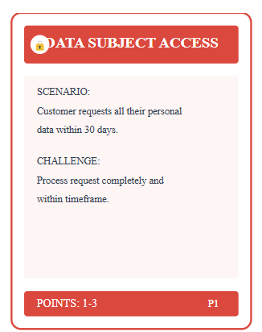
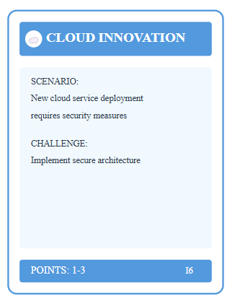
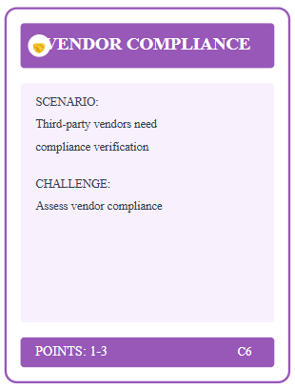
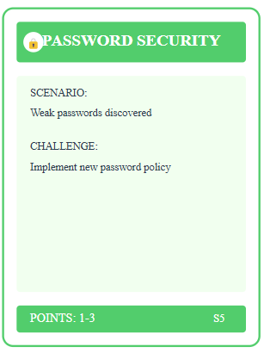
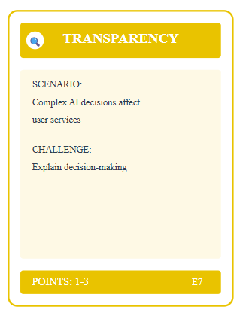
CHALLENGE CATEGORIES
Security (Green)
Risk management
Incident response
Access control
Ethics (Yellow)
AI bias
Fairness
Transparency
Privacy (Red)
Data protection
User rights
Information handling
Innovation (Blue)
Emerging technologies
Digital transformation
Privacy by design
Compliance (Purple)
Regulatory requirements
Documentation
Policy implementation

Slide 6

PLAYER ROLES
Available Roles:
Data Protection Officer
Security Officer
Ethics Officer
Privacy Analyst
Compliance Manager
Data Scientist
Each role includes:
Special abilities
Unique perspectives
Resource advantages

Slide 7





HOW TO PLAY?
Step 2: Draw challenge cards
Step 4:
Earn points
Step 1: Select roles
Step 3: Discuss solutions & make decisions.
Step 5:
Progress through phases

Slide 8

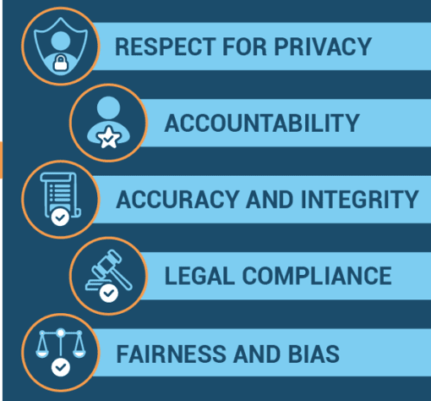
EDUCATIONAL BENEFITS
Learning Outcomes:
Practical application of data ethics
Real-world scenario experience
Team decision-making skills
Regulatory compliance understanding
Risk assessment capabilities
Measured Improvements:
Knowledge retention
Engagement levels
Practical application

Slide 9



IMPLEMENTATION AREAS
Academic Settings
Computer science courses
Ethics classes
Professional development
Where to Use Ethics Quest:
Corporate Training
New employee orientation
Compliance training
Team building
Professional Certification
Exam preparation
Skill enhancements

Slide 10
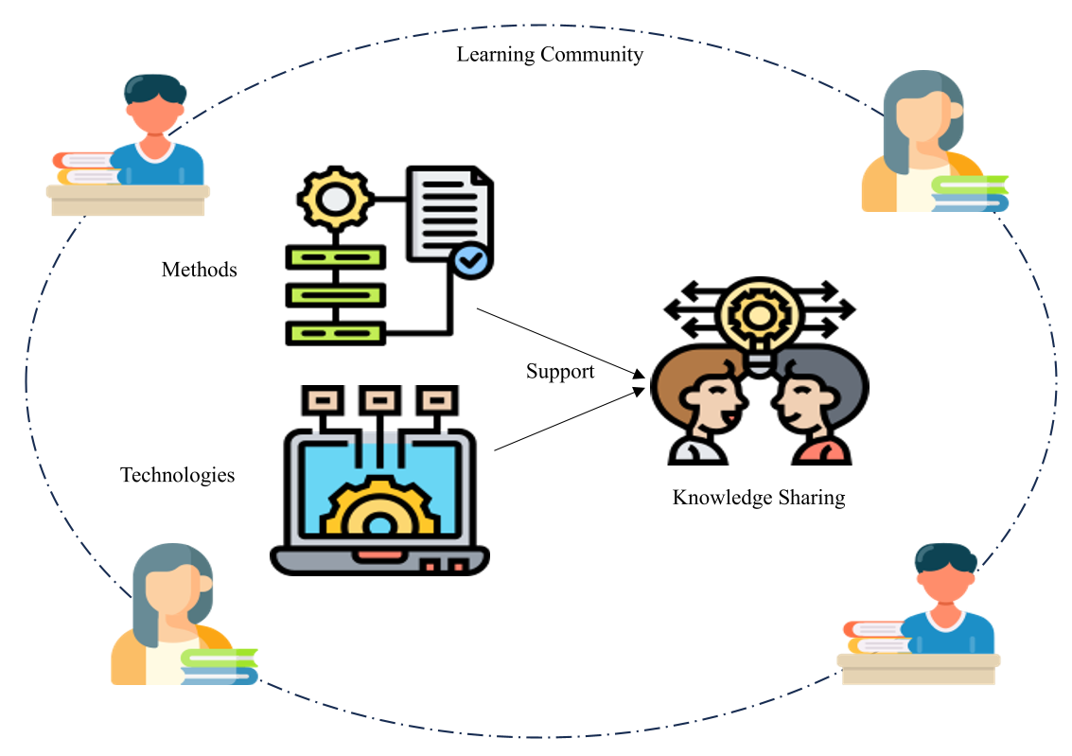

EVIDENCE OF SUCCESS
Research Results:
Knowledge Assessment
40% improvement in understanding
94% completion rate
85% practical application
Long-term Impact
78% knowledge retention
90% team collaboration improvement
Positive feedback from stakeholders

Slide 11


FUTURE DEVELOPMENT
ROADMAP:
Phase 1: Digital Version
Online platform
Remote play capabilities
Automated scoring
Phase 2: Industry Expansions
Healthcare
Finance
Education
Phase 3: Corporate Customization
Company-specific scenarios
Custom branding
Specialized training modules

Slide 12


KEY RESOURCES AND NEXT STEPS
Resources:
Game documentation
Training materials
Support channels
Next Steps:
Implementation guide
Pilot program
Customization options

Slide 13
Thank You
Questions?

